Slide 1
VanPak 2014
Lesson 2

Slide 2
Present work from last week
(if you did not get a chance to share your work from last week)

Slide 3
Inventions

Slide 4
What is an invention?
An invention is "the discovery or creation of a new material (either a new manufactured product or a new composition or matter), a new process, a new use for an existing material, or any improvements of any of these."

Slide 5
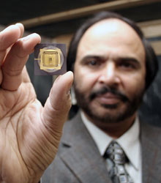
Pakistani Inventors
Naweed Syed:
First scientist to “connect brain cells to a silicon chip” – progresses artificial limbs and memory loss

Slide 6
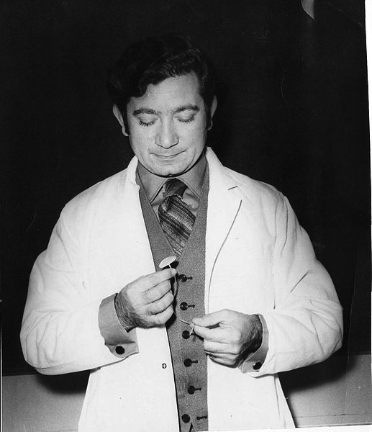
Ayub
Ommaya
Invented the Ommaya reservoir, which provides chemotherapy directly to brain tumors

Slide 7
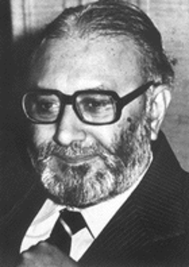
Abdus Salam
Independently predicted the existence of the Higgs Boson, the famous particle found in 2013 that helps explain why matter exists

Slide 8
Why is science so important?
Science surrounds us
Science is a way of knowing and thinking about the world. Observing, measuring, predicting and communicating are some of the skills fundamental to science. Science is a 'way of knowing.'

Slide 9
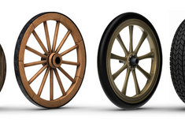
Inventions that changed the world!
THE WHEEL
When the wheel was invented, people could easily transport themselves, and goods, to and from markets!

Slide 10
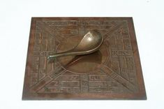
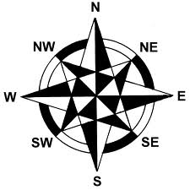
The Compass
People used to use the stars to navigate but after the first compass was invented in China, navigators could travel far from land. This increased trade and exploration.

Slide 11
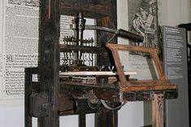
The Printing Press
Printing presses could make books quickly. It permitted wider access to books, which led to better education across the world!
What is your favorite book? Why?

Slide 12
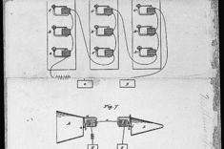
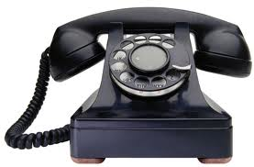
The Telephone
The telephone allowed people to talk across the country! Alexander Graham Bell was awarded the patent for the first telephone. It revolutionized the world!

Slide 13
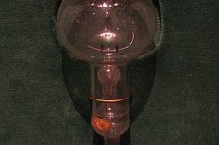
The Light bulb
After the invention of the light bulb, people were not limited to working during daylight hours. Thomas Edison is credited as the primary inventor.

Slide 14
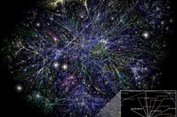
The Internet
This global system of information is probably one of the greatest inventions of our time! It is the reason we can even talk to one another today!

Slide 15
What would be your
Invention if you could
Create anything with
Unlimited resources?

Slide 16
What is your favorite
modern invention?

