Slide 1
VanPak
November 2013

Slide 2
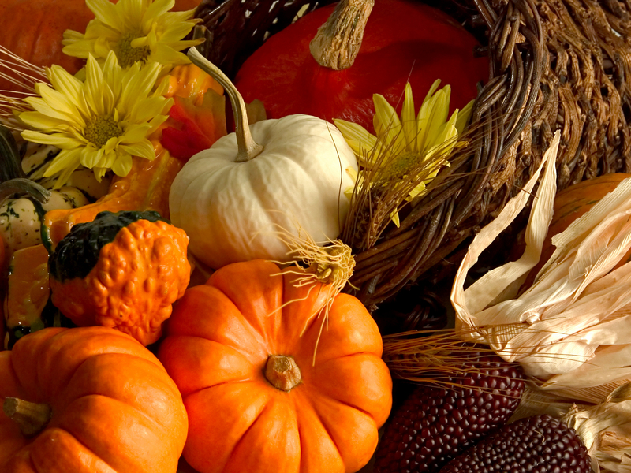
American
Thanksgiving!

Slide 3
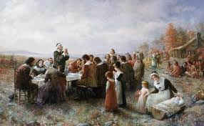
History
Before settlers from England came to America, the land was occupied by Native American tribes. Then a group of English Protestants came to break away from the Church of England and formed the Plymouth Colony in America. One of the tribes helped the new settlers to learn to grow corn and fish to survive. The settlers and the Native Americans then formed a friendship to help each other and celebrated the first harvest with a feast together. This feast became the tradition of Thanksgiving.

Slide 4
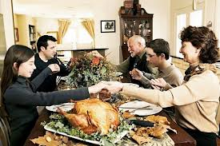
Thanksgiving Now
It is a time to get together with family and celebrate all the things we are thankful for. Everyone will sit around a big table for a feast and start by going around and sharing what they are thankful for.

Slide 5
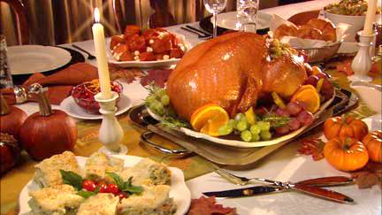
THE FOOD

Slide 6
What they at the first
Thanksgiving
Deer meat
Corn
Shellfish
Roasted Meat
Cranberries

Slide 7
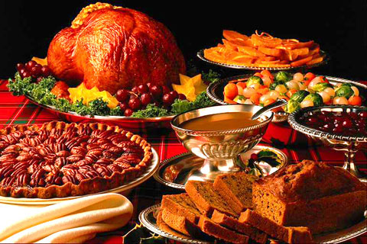
What we eat now at Thanksgiving
Turkey
Corn
Mashed Potatoes
Stuffing
Pumpkin Pie
Green Beans
Cranberries

Slide 8
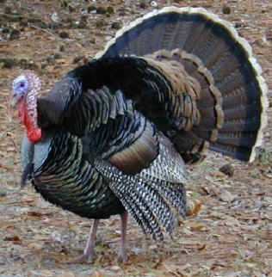
Over 40 million
Turkeys eaten in
The US!

Slide 9
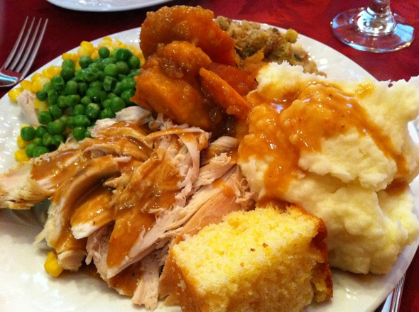
Over 3000 calories consumed
on average per American!
As a comparison, the average
American woman eats 2000
Calories per day.
(Men eat ~2500)

Slide 10
What are some things that
you thankful for?

