Slide 1
VanPak
November 2013

Slide 2
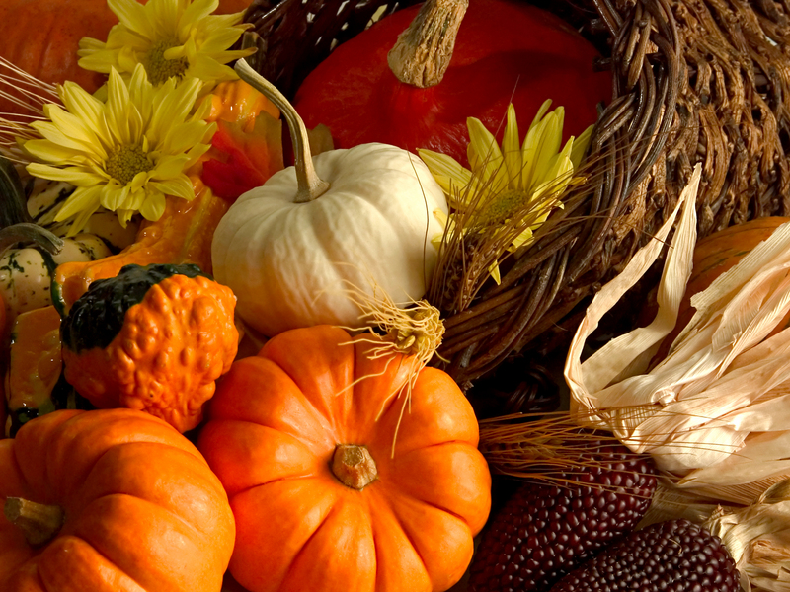
American
Thanksgiving!

Slide 3
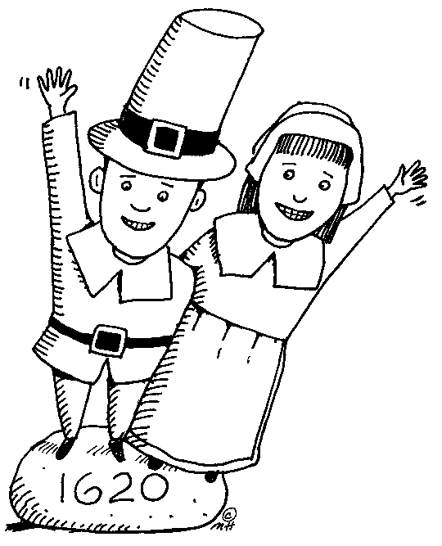
History
Pilgrims came
from England
on the
Mayflower

Slide 4
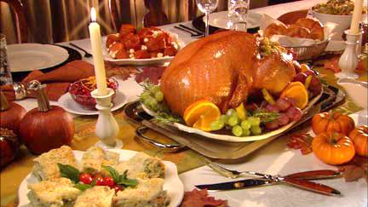
THE FOOD

Slide 5
Thanksgiving is traditionally
a time that people spend
with their families.
People sit around a big
table, and the cooking takes
all day.

Slide 6
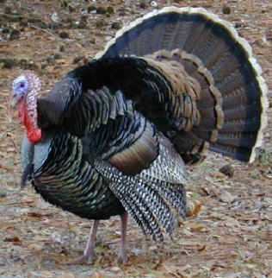
Over 40 million
Turkeys eaten in
The US!

Slide 7
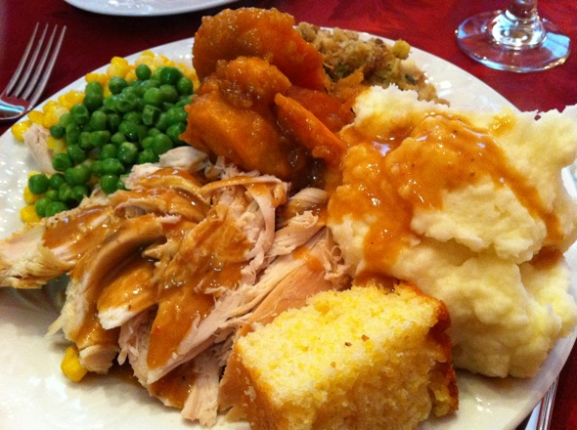
Over 3000 calories consumed
on average per American!
As a comparison, the average
American woman eats 2000
Calories per day.
(Men eat ~2500)

Slide 8
A tradition is to go around
the table and tell everyone
what you are thankful for.
What are you all
thankful for this year?

