Slide 1
Vanderbilt-Pakistan
November 5th 2013
Notes:
Here is where you will introduce yourself to your students. Talk about your major, your interests, etc etc.

Slide 2
“Food is our common ground, a universal experience.”
“Ask not what you can do for your country. Ask what’s for lunch.”
― Orson Welles
“If more of us valued food and cheer and song above hoarded gold, it would be a merrier world.”
“One cannot think well, love well, sleep well, if one has not dined well.”
― Virginia Woolf
“We must have a pie. Stress cannot exist in the presence of a pie.”

Slide 3
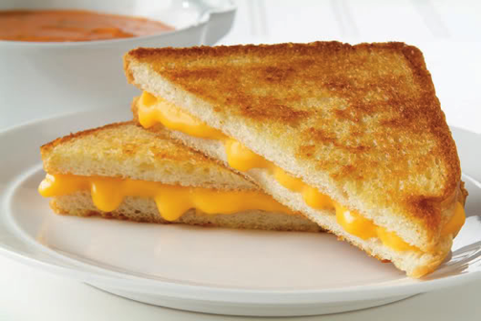
Grilled
Cheese
INGREDIENTS: Butter, white bread, slices of cheese
WHAT IS IT? A sandwich with fried butter on the outside and melted cheese on the inside. Mmmmm…

Slide 4
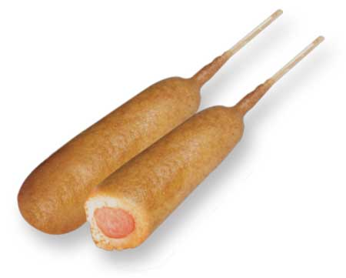
Corn
Dogs
INGREDIENTS: Cornmeal, flour, salt, pepper, sugar, baking powder, eggs, milk
WHAT IS IT? A frankfurter (hot dog) dipped in the mixture above and fried

Slide 5
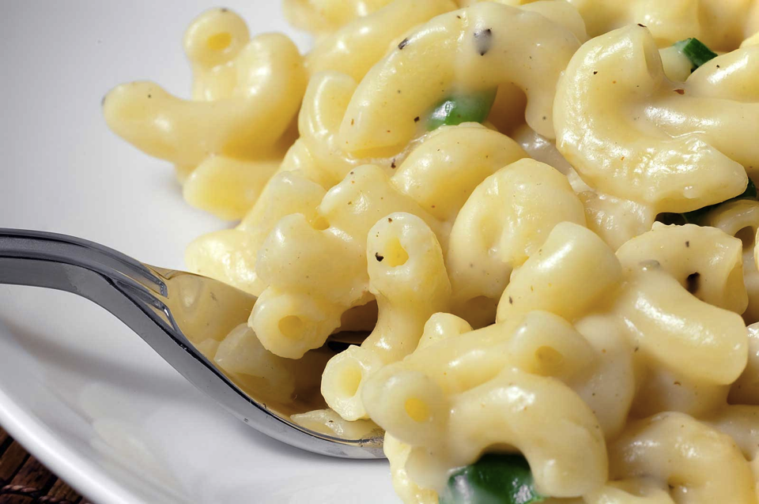
Macaroni and Cheese
Mix melted cheddar cheese and elbow noodles and you’re done!

Slide 6
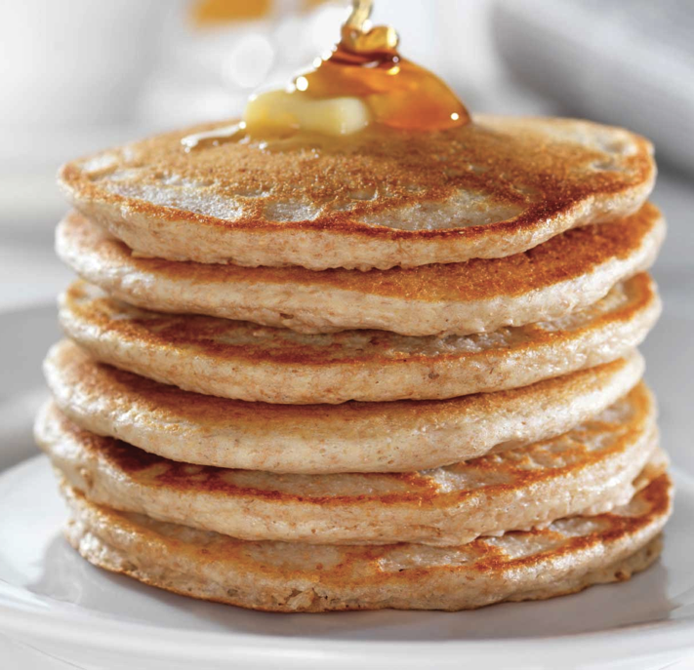
A pancake is a thin, flat, round cake prepared from abatter and cooked on a hot griddle or frying pan. It is traditionally eaten for breakfast. You can put chocolate chips, fruit, nuts, and whipped cream on top!

Slide 7
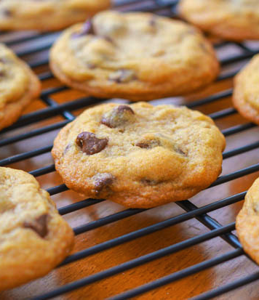
Chocolate Chip Cookies
INGREDIENTS: Butter, white and brown sugar, eggs, vanilla, baking soda, salt, flour, chocolate chips

Slide 8
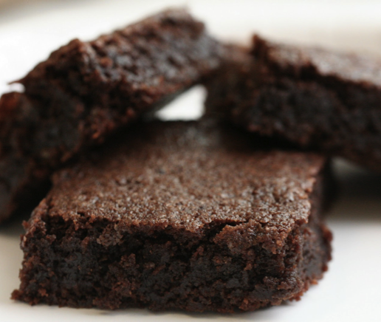
Brownies
INGREDIENTS: Chocolate, butter, eggs, sugar, vanilla, baking powder, salt
WHAT IS IT? flat, baked square or bar. The brownie is a cross between a cake and a cookie in texture.

Slide 9
Americans can be very creative
With their desserts…

Slide 10
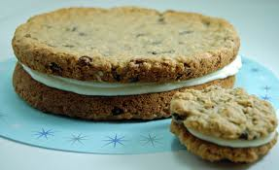
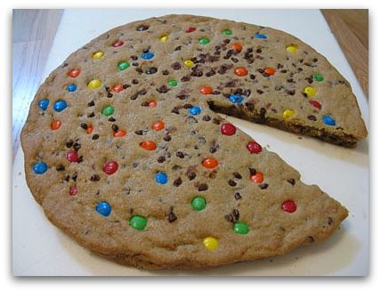
Cookie cake (below): A giant cookie that is the size of a cake
Cookie sandwich (two cookies with white crème filling between them)

Slide 11
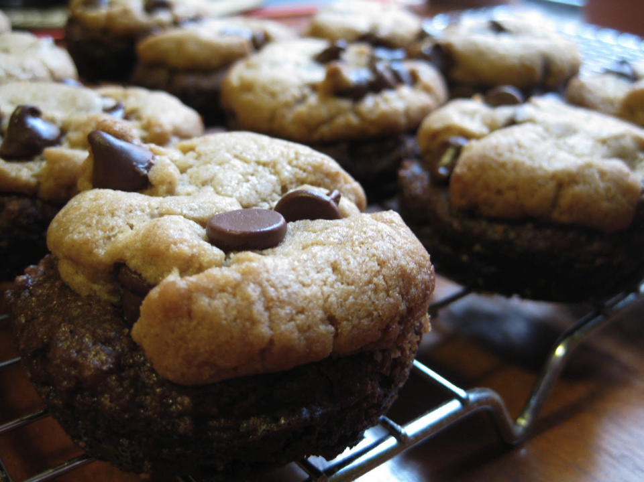
Brookie: A combination
of a brownie AND
a cookie!

Slide 12
What do you eat in Pakistan?
Give us more details about
the following foods…

Slide 13
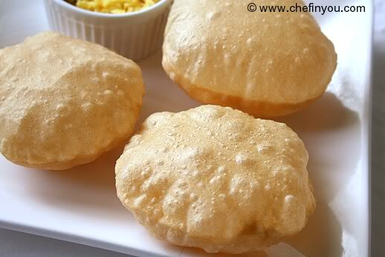
Poori
A flat bread made of white flour which is deep fried for 2-3 seconds till it blows up into a ball. It is very soft and crispy

Slide 14
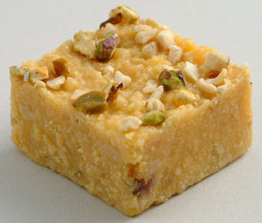
Halwa
A sweetmeat made with semolina and loaded with sliced almonds and pistachios.

Slide 15
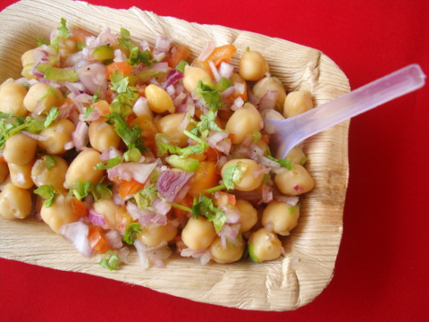
Curry
It is called Aloo choolay, which means potato and chickpea curry. It is very spicy and very tasty.

Slide 16
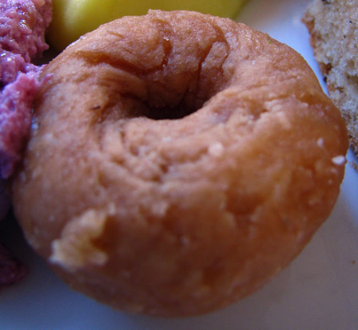
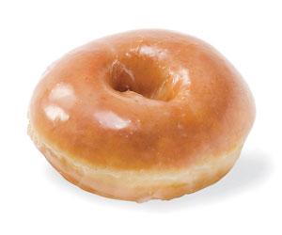
Balushahi
Donut
vs

Slide 17
So who’s hungry?
I know I am!

