Slide 1
Vanderbilt-Pakistan Lesson 3
January/February 2013
Notes:
Here is where you will introduce yourself to your students. Talk about your major, your interests, etc etc.

Slide 2
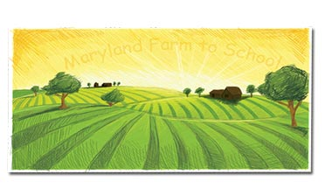
Knoxville Tennessee by Nikki Giovanni
I always like summer
Best
You can eat fresh corn
From daddy’s garden
And okra
And greens
And cabbage
And lots of
Barbeque
And buttermilk
And homemade ice-cream
At the church picnic
And listen to
Gospel music
Outside
At the church
Homecoming
And go to the mountains with
Your grandmother
And go barefooted
And be warm
All the time
Not only when you go to bed
And sleep
Notes:
Make sure they know the veggies.

Slide 3
Questions
I always like summer
Best
You can eat fresh corn
From daddy’s garden
And okra
And greens
And cabbage
And lots of
Barbeque
And buttermilk
And homemade ice-cream
At the church picnic
And listen to…
How can you use poems differently than stories to tell people about a place?
How are the adjectives in this poem effective? (fresh, warm, homemade)
Imagery in English describes when the author uses words that the reader can hear, taste, touch, smell, or feel. In this case, the author talks mostly about food, making the poem feel like home.
How do you feel when you read this poem? What kinds of words make you feel that way?
Notes:
Poems can be very exact, like this one, or they can create an image that is very hard to figure out.
Feels like home to me.

Slide 4
Which foods would you pick to represent your home to someone else?

Slide 5
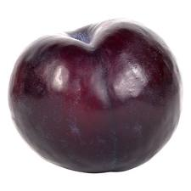
This Is Just to Say by William Carlos Williams
I have eaten
the plums
that were in
the icebox
and which
you were probably
saving
for breakfast
Forgive me
they were delicious
so sweet
and so cold

Slide 6
Questions
I have eaten
the plums
that were in
the icebox
and which
you were probably
saving
for breakfast
Forgive me
they were delicious
so sweet
and so cold
This poem was written as “found poetry,” because it feels like the reader is looking at a note that was written for somebody.
The only image directly in this poem is of the plum.
What other image can you see when you read this?
Notes:
To me, I imagine a wife waking up early in the morning to find this note on a wooden table. And I can paint a picture about her life, and her husband’s life around these few words.

Slide 7
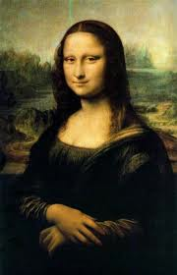
If you saw these paintings lying in a trash can on the street, would you stop and look at them? Would you think they were trash or treasure?
Notes:
Just describe that these are examples of magazine covers in the US and Pakistan.

Slide 8
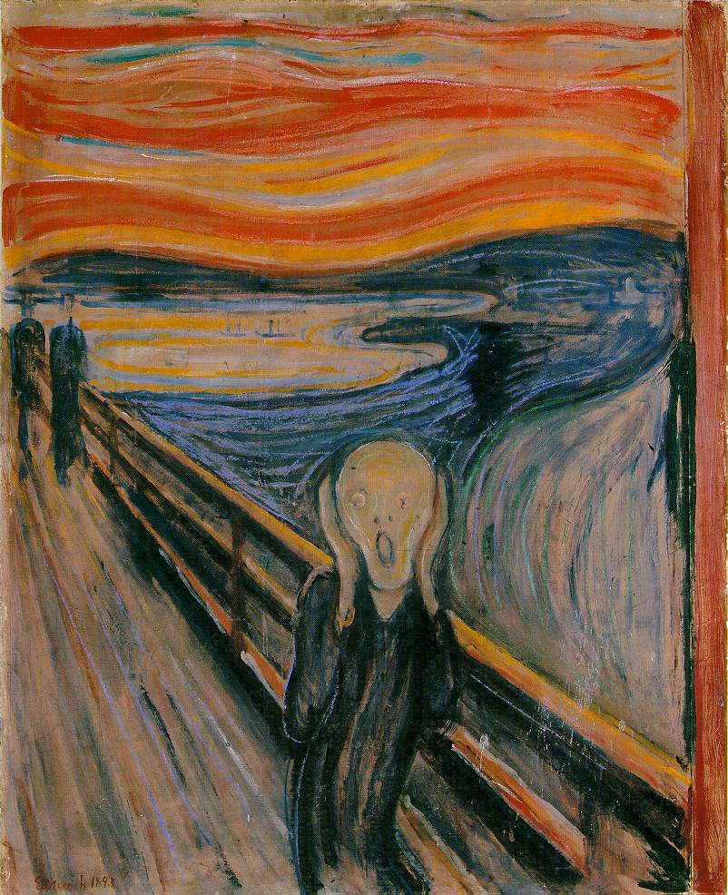
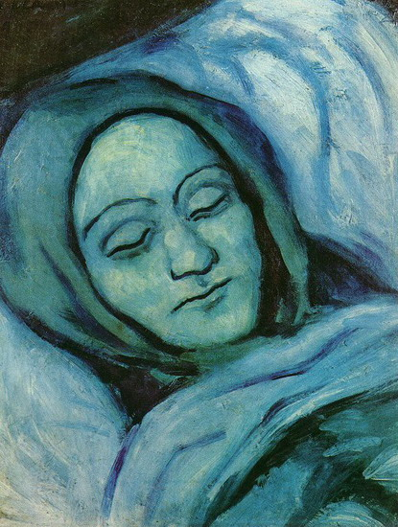

Slide 9
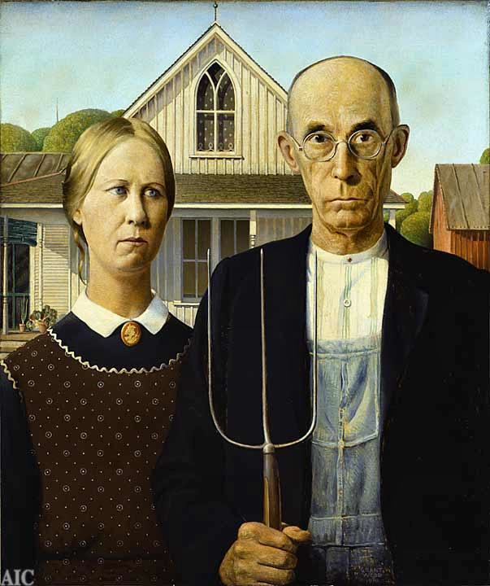
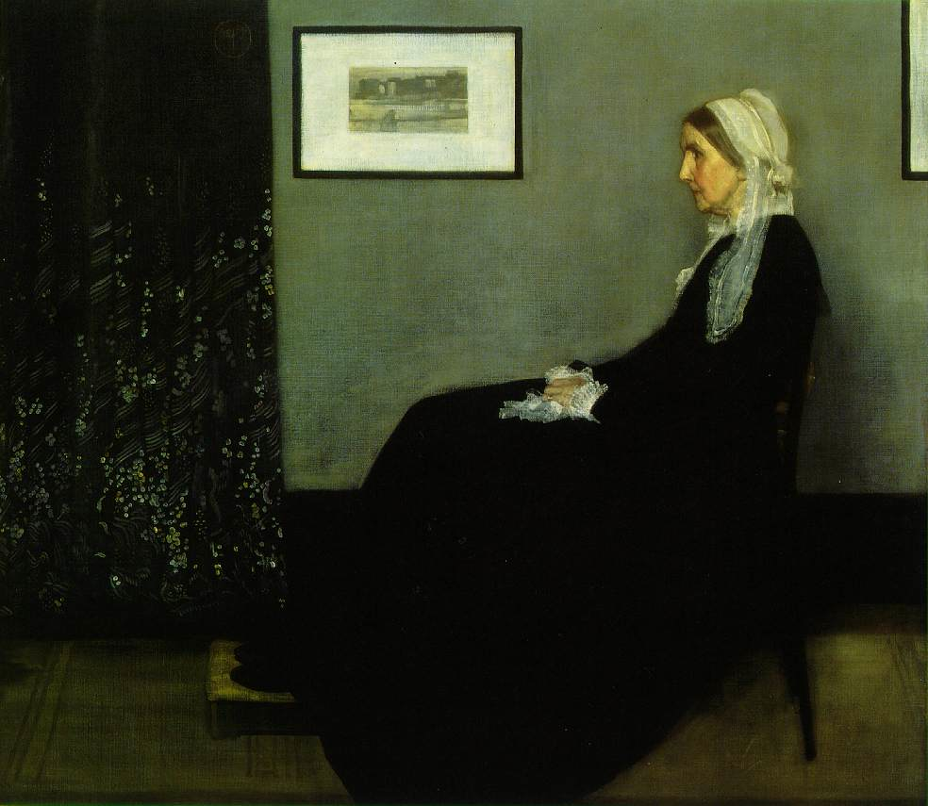

Slide 10
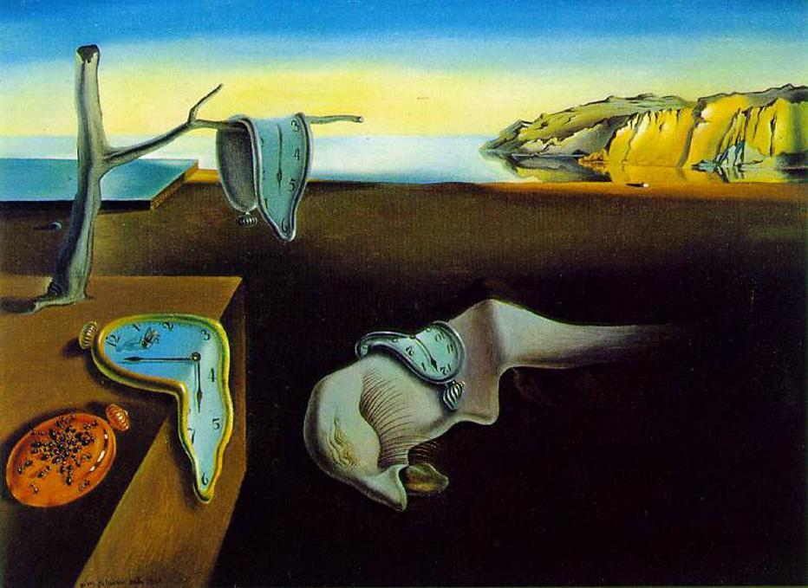

Slide 11
What do you think determines the value of a particular piece of artwork/poem? Class Ideas: -History -Unique -Specific Qualities -Some great idea -Debate -Information about artist
Notes:
It’s about what you can get out of it. It should speak to everyone in some way.

Slide 12
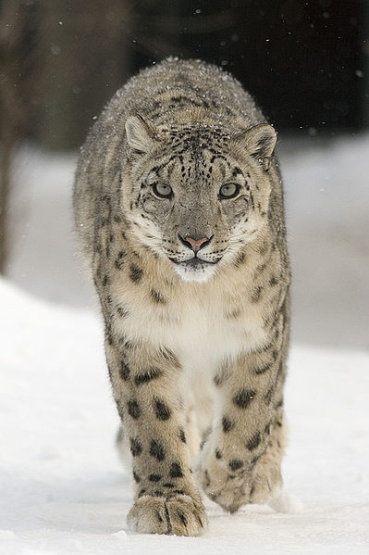
The Snow Leopard
He pads on grassy banks
behind a fence,
With measured paces
slow and tense
Beyond his cage
his thoughts are sharp and white
He lives a compelled anchorite
A solid ghost
gone blind with all the green,
he waits and waits to be unseen.

Slide 13
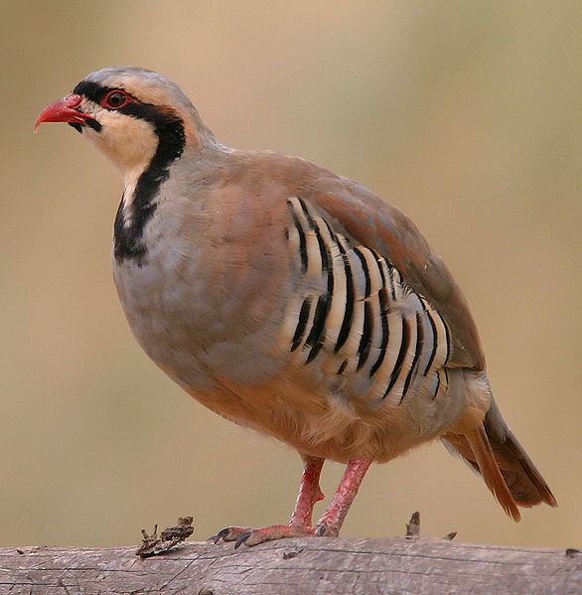
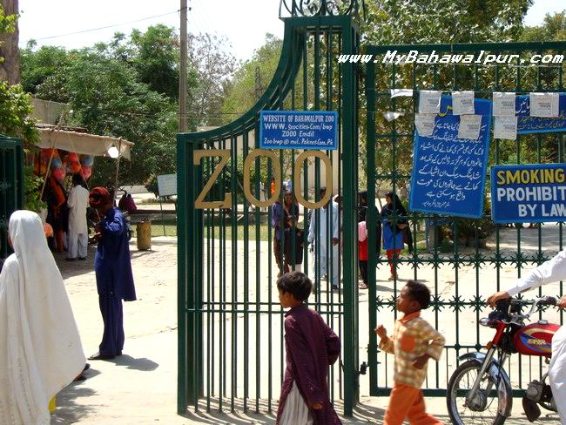
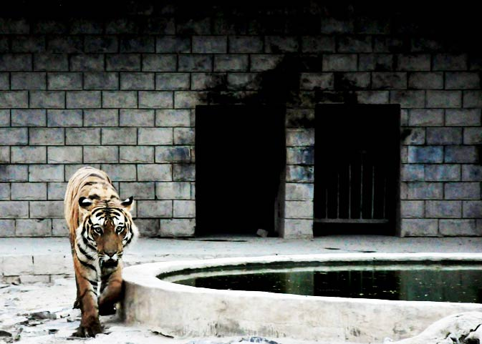
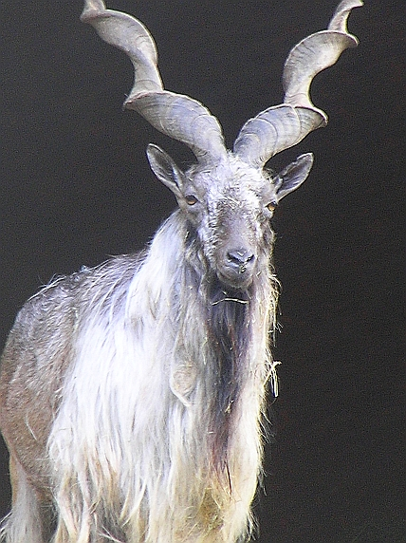
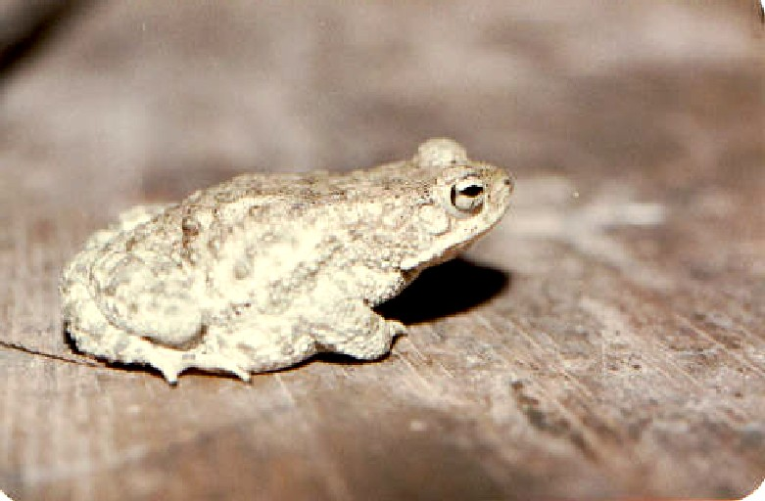
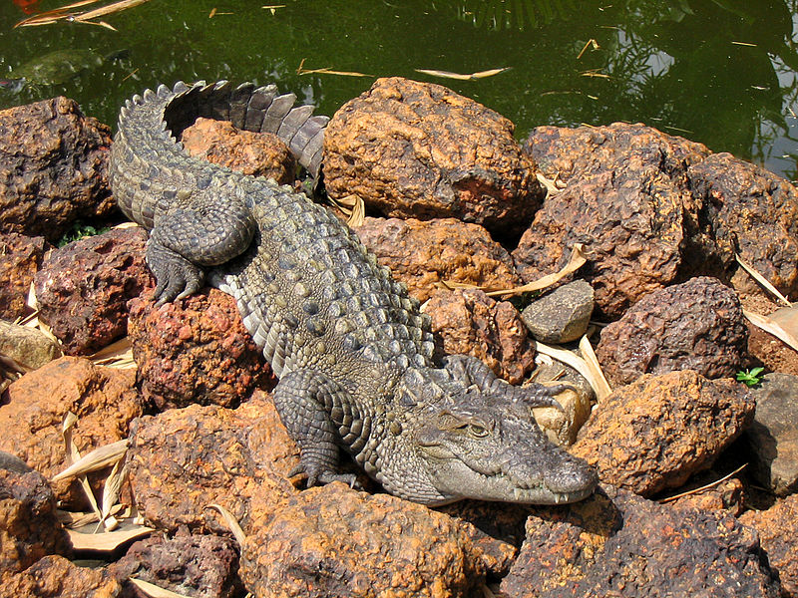
Animals of Pakistan

Slide 14
What do you think determines the value of a species of animal?
Class Ideas:
-Meat, milk
-Rare, valued
-Transportation
-Beautiful
-Safety (protection)
-Environment healthy

Slide 15
Classwork
Write a poem or paragraph about your home, using adjectives (descriptive words).
You can include information about your food, sport, culture, animals, or anything else you can think of!

Slide 16
Homework
Draw a picture of your favorite animal in Pakistan and explain why it is valuable. This animal can be a wild animal or it can be a domesticated animal. Write a short paragraph or poem explaining the importance of this animal for humans and/or for the environment.

