Slide 1
American Education System
Preschool – College Admissions

Slide 2
Pre-School
Pre-School is an optional program for children too young to enter Kindergarten. In pre-school, a child basically learns how to behave and interact with others.
Pre-School can last anywhere from 1-3 years.

Slide 3
Pre-School

Slide 4
Kindergarten
Literally: “children’s garden”
Kindergarteners are 5-6 years old
Children begin learning how to read and write. They also begin using numbers up to 100.
Children will be able to recognize basic shapes, colors, and concepts (such as months of the calendar).

Slide 5
Kindergarten

Slide 6
1-5 grades
By 5th grade, students should be able to add, subtract, multiply, and divide as well as work with fractions and decimals and notice patterns. They should also know basic formulas (volume, area, perimeter).
Fifth graders should know the basic terms and processes of a wide range of sciences. (Basics of biology, physics, earth science, etc.)

Slide 7
1-5 grades
Children can read books and write papers (with decent grammar) efficiently. They should be able to summarize passages.
They should have a general knowledge of the American government, American history, and the geography of The United States.
Art and music classes are also available. There is usually a school play everyone must participate in.

Slide 8
5th Graders

Slide 9
6-8 grades
“Middle School” is a time for children to dig a little deeper into the general basics of math, English, history, science, and reading.
Students will have a more comprehensive knowledge of topics but will not be familiar with the more difficult specifics of an area.
These are the years where students begin joining clubs and doing competitions they are interested in. (Example: spelling bees)

Slide 10
8th Grader

Slide 11
9-12 grades
“High School” is a time for students to begin finding their interests and choosing their own classes. Topics are no longer broad.
Science → biology, chemistry, physics, anatomy, earth science
Math → algebra, geometry, trigonometry, calculus, statistics
Social Studies → world history, American history, European history, world religions

Slide 12
9-12 grades
English → composition, literature.
Technical → carpentry, welding, health science
Others → psychology, Spanish, Latin, French, art, theater, choir

Slide 13
9-12 grades
In high school, there are a lot more clubs, sports, competitions, or extracurricular activities students can participate in. The number of clubs/competitions/extracurricular activities you participate and excel in is a HUGE factor in applying for college.
Student who get into elite universities begin as early as possible to boost their applications.

Slide 14
Types of Clubs/Competitions
Health, math, science, language, writing, environment, service, student government, newspaper, yearbook, religious.
Most of these clubs help members prepare for lots of competitions throughout the year.

Slide 15
Extracurricular Activities
Soccer, football, track and field,
volleyball, softball, baseball,
basketball, tennis,
swimming.
Theater,
marching band

Slide 16
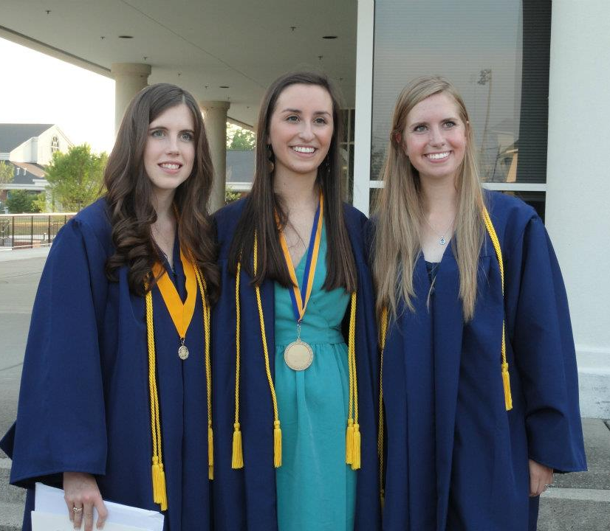
High School Students

Slide 17
College Admissions
High school is a time for students to begin working on their resumes to turn in to colleges.
Things to do to make your resume look nice:
good grades in challenging courses
high test scores
community service
wide range of extra participation, leadership
summer activities, and good essays.

Slide 18
Challenging Courses
Challenging courses: for every class, there is a harder version offered. Example: pre-calculus, regular calculus, AP/IB calculus.
AP and IB courses are college-level courses offered in high school in which a student can take a test. If they receive a certain grade (changes from college to college) they can ‘test out of’ that course in college and receive credit for it.
. Of course, if you can make good grades in the more difficult courses, that is good for you!

Slide 19
Standardized Tests
ACT/SAT: nationally recognized exams
Along with AP exams, students must take the ACT or SAT to submit their scores to colleges. These tests cover reading, writing, science, and math. Scores indicate how much a student has learned and how well they will do in colleges.
These scores are among the biggest factors of getting into college.

Slide 21
Community Service
A college not only wants a good student, they want an actively engaged citizen. Colleges want to know that you are passionate about something and making a difference in your community. If you are, it makes them think that you will make a positive impact on THEIR campus, too!

Slide 22
Community Service

Slide 23
Wide Range of Extra Participation/Leadership
Colleges want leaders.
A way to show that you’re a good leader is to be the head of a club, president/vice-president/etc. of your class, or a sports team captain.
These are positions you rise into after 3-4 years of dedicated participation.

Slide 24
Summer Activities/Good Essay
A college doesn’t want a student who only does well during the year. They want students who show that they can work hard even outside of school. Doing volunteer work or attending academic camps is a good way to do that!
As always, a unique, amazing essay is key. Of the thousands applying, there are so many students just like you. The one way to stand out is to write an essay no one else has written. It should be totally unique.

Slide 25
Summer College Program!

Slide 26
Benefits of Going to College
Since the economy has been slow, having a college degree increases your chance of getting a job.
The higher the degree, the better your chances. (Bachelor’s, Master’s, M.D., Ph.D.)
Meet new people from all around the world – like you!
Learn new things.
Find your passion.

Slide 27
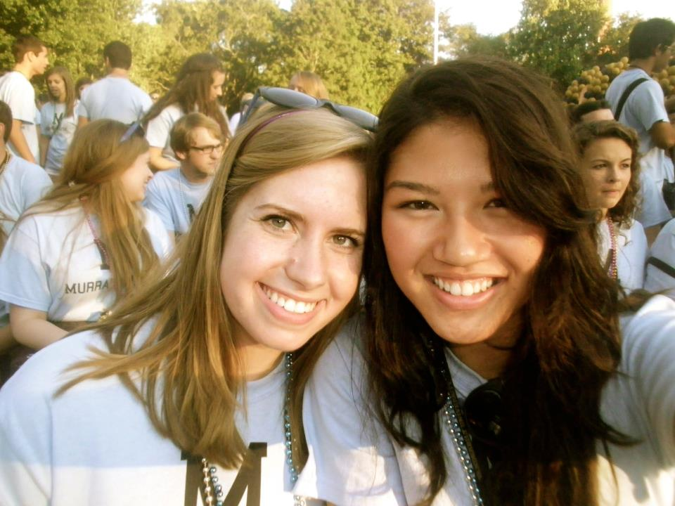
College Acceptance
If the college likes you and thinks you’re a good fit, you’re in!!
Official college
students!! →

