Slide 1
What We Wear… What Do You Wear?

Slide 2
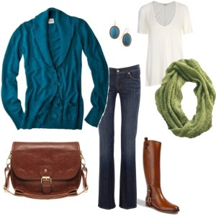
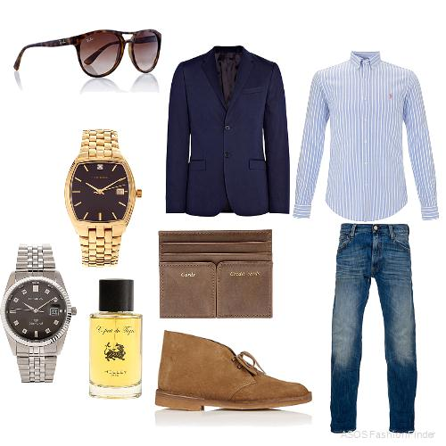
Casual

Slide 3
What Do You Wear?

Slide 4
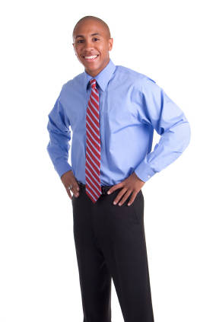
Business Casual

Slide 5
What Do You Wear?

Slide 6
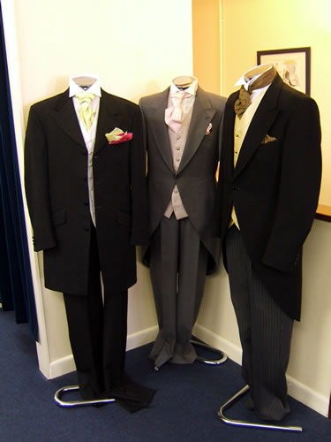
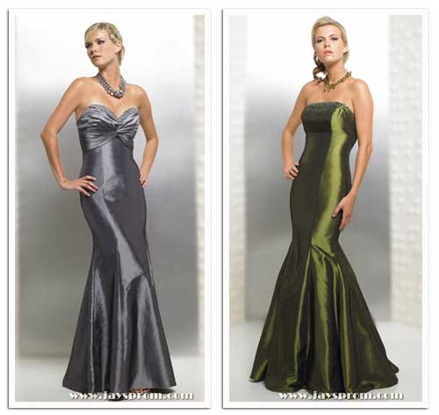
Formal

Slide 7
What Do You Wear?

Slide 8
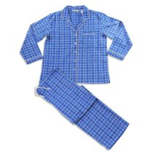
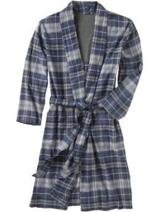
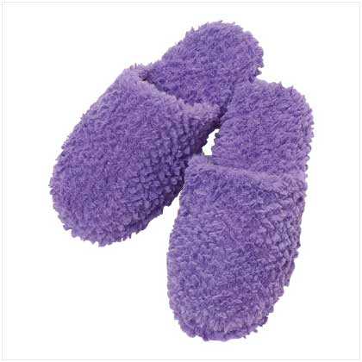
To Sleep

Slide 9
What Do You Wear?

Slide 10
Who Wears A Uniform?
What Do They Wear?

Slide 11
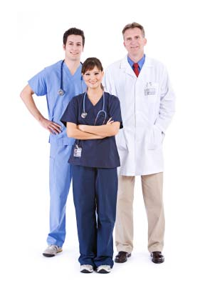
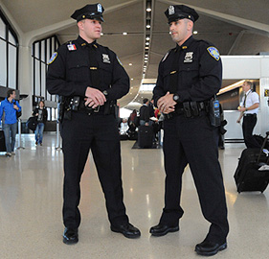
People in Uniform

Slide 12
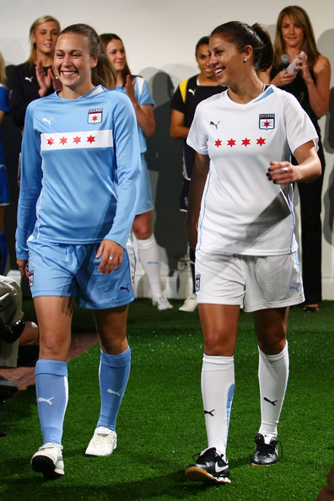
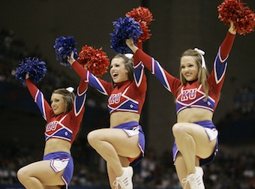
People in Uniform (continued)

Slide 13
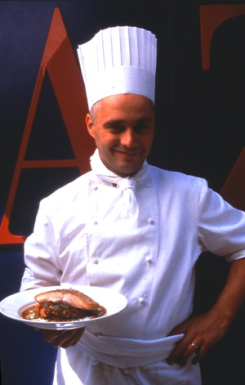
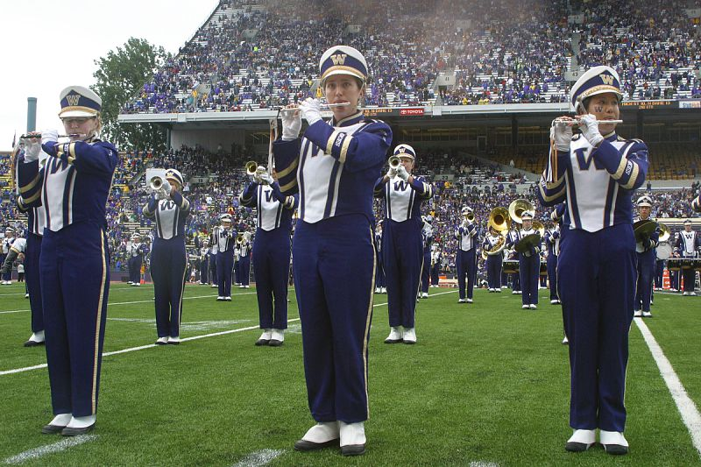
People in Uniform (continued)

Slide 14
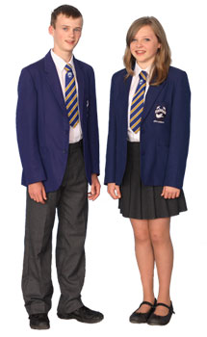
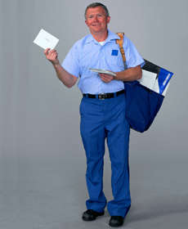
People in Uniform (continued)

Slide 15
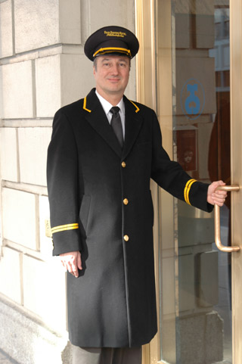
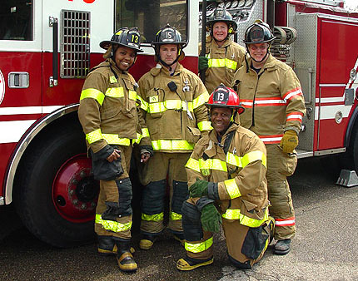
People in Uniform (continued)

Slide 16
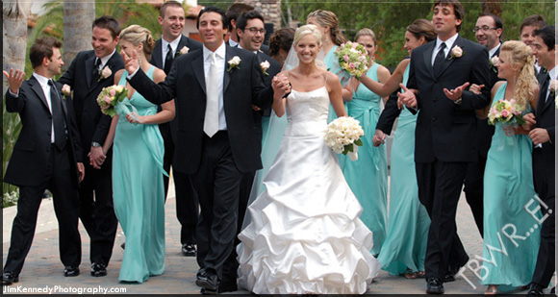
Wedding

Slide 17
What Do You Wear During Weddings in Pakistan?

Slide 18
What Other Events Require A Certain Type Of Dress in Pakistan?

Slide 19
Here Are Two Examples In The U.S.

Slide 20
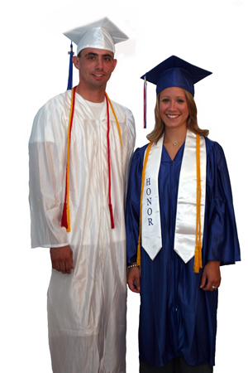
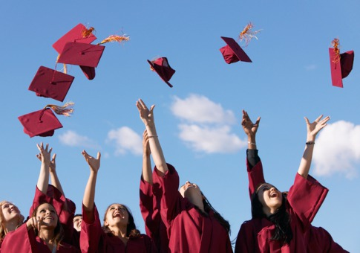
Graduation

Slide 21
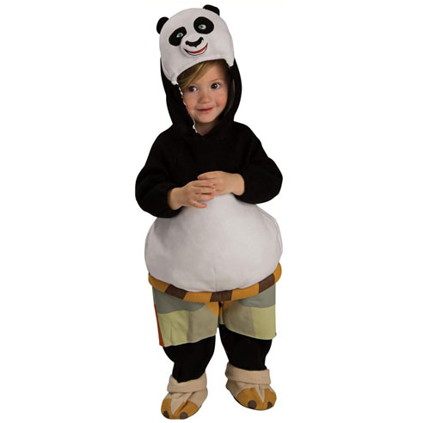
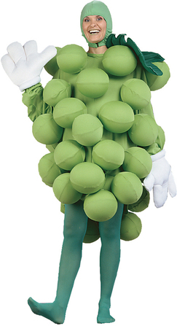
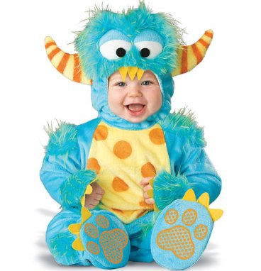
Halloween

Slide 22
And We Can’t Forget The Animals!!

Slide 23
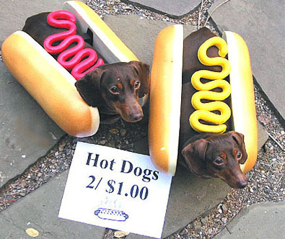
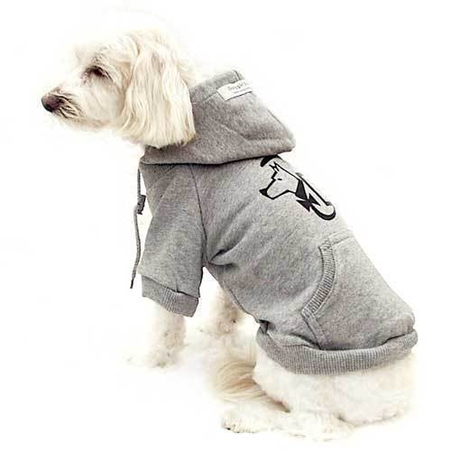
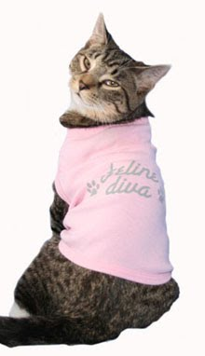
Animals

Slide 24
Homework
Clothing is one aspect of daily life that we all share: We all wear clothes, right…?
And don’t we all eat? We even celebrate a lot of the same events (such as birthdays and weddings)
Yet even though we often share many of the same types of experiences, there are often many interesting and beautiful differences between the way we celebrate.
Your homework is to choose an event or holiday in Pakistan, and to write one paragraph describing how people dress, what people eat, and what they do during the celebration (feel free to draw picture(s)!).

