Slide 1
Monday, October 28

Slide 2
Anything you want to share?

Slide 3
Halloween! October, 31st

Slide 4
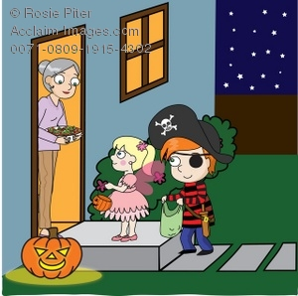
Trick or Treating

Slide 7
Flags!

Slide 9
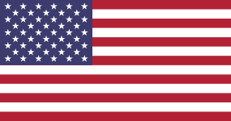
American Flag
50 stars represent unity of the 50 states of the USA
The 13 stripes honor the history of the US through its 13 original colonies
White signifies purity and innocence
Red represents hardiness & valour
Blue signifies vigilance, perseverance & justice

Slide 10
Pakistani Flag
The crescent represents progress
The star symbolizes light and knowledge
White = peace and honesty & symbolizing the role of religious minorities
Green = hope, joy and love and has a sacred significance representing Islam

Slide 11
State Flags: Do you have regional flags?
Massachusetts
New Jersey

Slide 12
Homework:
Draw a flag that represents the whole world

