Slide 1
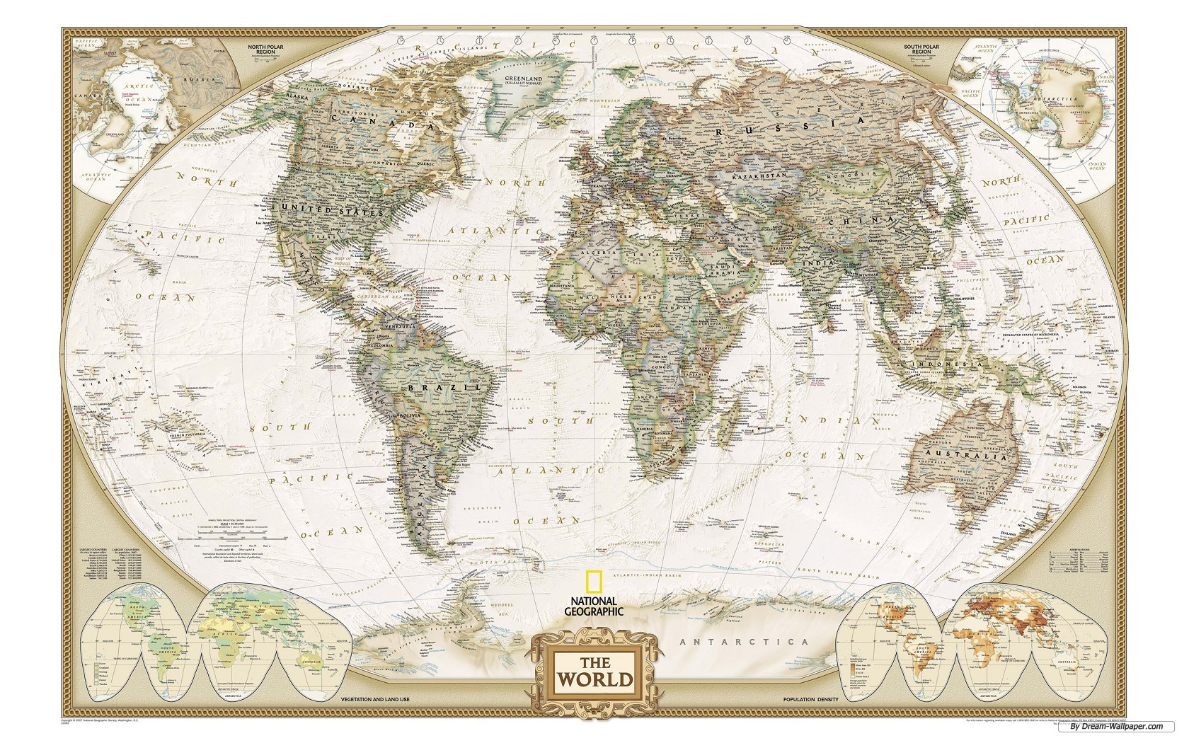
Places

Slide 2
Oh, the Places You’ll Go

Slide 3
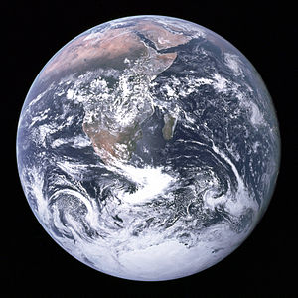
Lesson
This world is a big beautiful place with lots of different cultures, places and types of people.
Today we will learn about the geography of this world

Slide 4
Desert
What do you know about deserts? What comes to mind?

Slide 6
Jungle
What do you know about jungles? What comes to mind?

Slide 8
Mountains
What do you know about mountains? What comes to mind?

Slide 10
Discussion
What geographic setting do you live in?
-> Is there a desert near by? (Thar, Cholistan, Kharan)
What kind of geographic setting do you think the U.S. has?

Slide 11
Homework
If you could live in any geographic setting that we talked about today, which one would it be and why?

