Slide 1
VanPak Lesson 3
October 8 2013

Slide 2
Common American English Phrases of the Week

Slide 3
“big mouth”

Slide 4
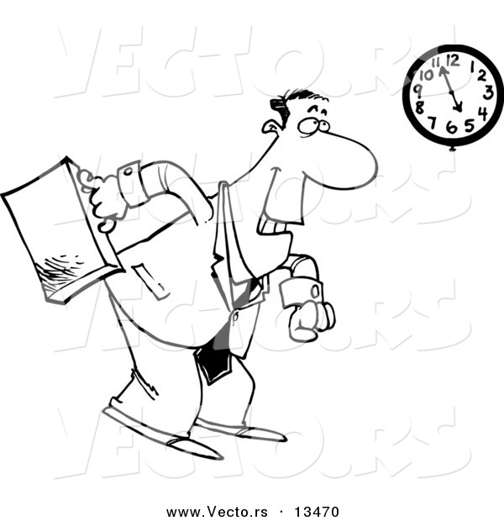
“call it a day”

Slide 5
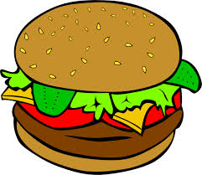
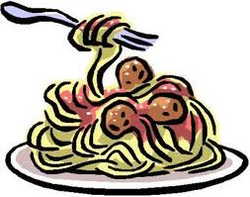
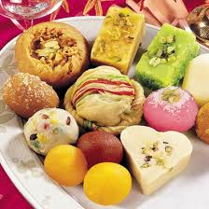
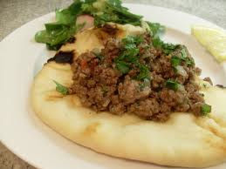
“hit the spot”

Slide 6
“rain or shine”

Slide 7
“take it easy”

Slide 8
FAMILY

Slide 9
What are some of your family traditions?
What do you on holidays?
Birthdays?
Food?

Slide 10
Family Relations
How do you see your siblings?
How do you interact with your parents?
How often do you see your extended family?

Slide 11
Defining a “family”
Dictionary definition: a group consisting of parents and children living together in a household.
Are there other ways to define a family other than people who are related to you? Can you think of other people who you might consider your “family”?

Slide 12
Homework:
Write a paragraph on what you hope your future family looks like. Do you want to get married? Do you want to have kids? Do you want a big house or a small house? Do you want animals?
Feel free to draw a picture too if you feel more comfortable with that.

