Slide 1
Culture

Slide 2
Definition
the quality in a person or society that arises from a concern for what is regarded as excellent in arts, letters, manners, scholarly pursuits, etc.

Slide 3
What do people say about culture?
“No culture can live if it attempts to be exclusive.”
–Ghandi
“Preservation of one's own culture does not require contempt or disrespect for other cultures.”
-Cesar Chavez
“I love where I'm from. I don't live there because of the circumstances, but all my family is there. It's what's inside, it's not what's outside that determines the culture and the feeling.”
-Maria Sharapova

Slide 4
What makes up OUR cultures?
History
Family
Traditions
Literature and Poetry
Religion
Music
Film
Art

Slide 5
American Literature

Slide 6
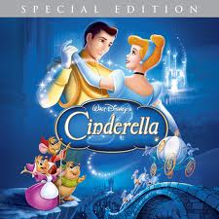
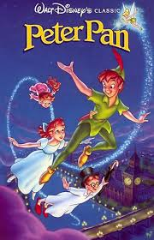
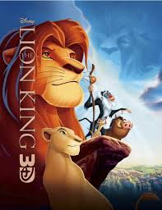
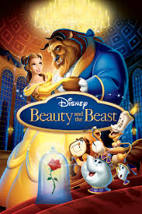
American Film
Disney Movies

Slide 7
American Film

Slide 8
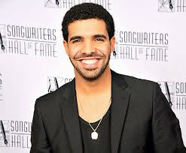
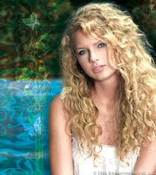
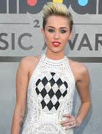
American Music
Taylor Swift
Drake
Miley Cyrus

Slide 9
Homework
Choose one of the following options:
Write a paragraph and draw pictures of the music, books, art, etc. that make up your culture.
Write a paragraph about what culture means to you. How do you define it for yourself? For your country? For the world?
Choose one of the quotes on Slide #3. Write a paragraph response. What does it mean to you?

