Slide 1
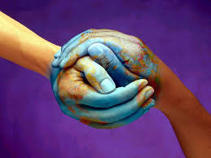
Culture

Slide 2
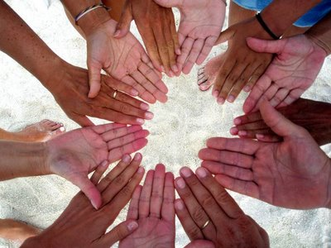
Definition of “Culture”
Culture is what defines a certain group of people or society.
Arts, manners, and scholarly achievements that are unique to that people are important parts of their culture.

Slide 3
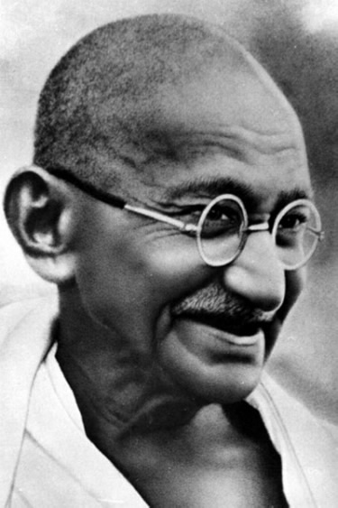
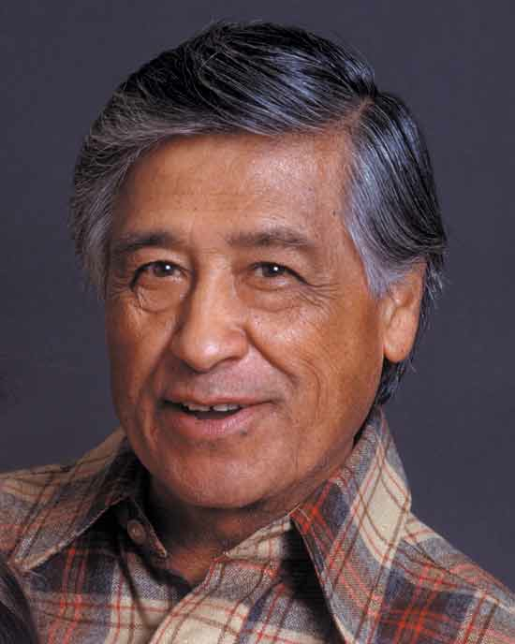
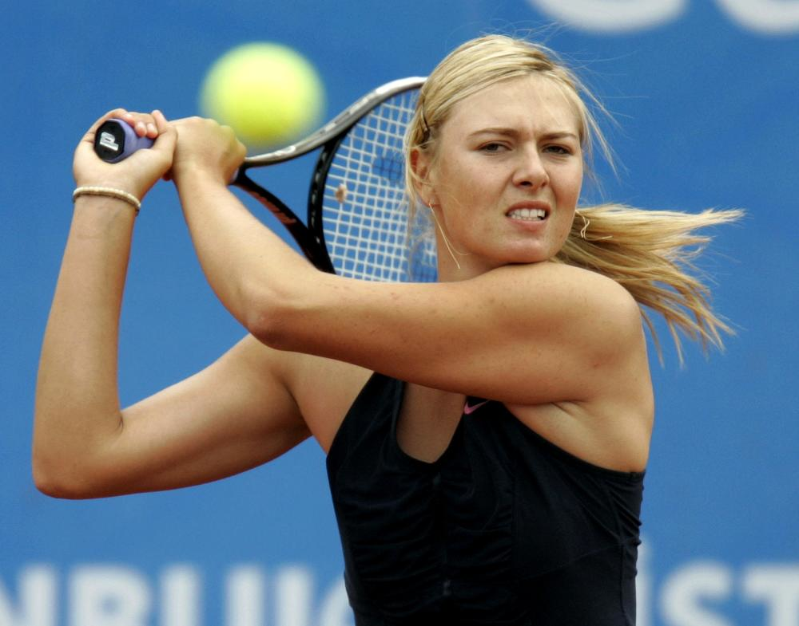
What do people say about culture?
“No culture can live if it attempts to be exclusive.”
-Ghandi
“Preservation of one’s own culture does not require contempt or disrespect for other culture.”
-Cesar Chavez
“I love where I’m from. I don’t live there because of the circumstances, but all my family is there. It’s what’s inside, it’s not what’s outside that determines the culture and the feeling.”
- -Maria Sharapova

Slide 4
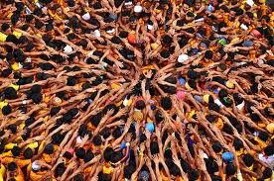
Culture creates and connects a community through commonality and mutual understanding.

Slide 5
What makes up OUR cultures?
History
Family
Traditions
Literature and Poetry
Religion
Music
Film
Art

Slide 6
American Literature

Slide 7
American Film

Slide 8
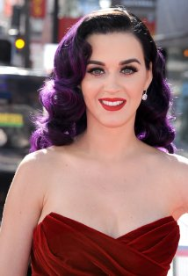
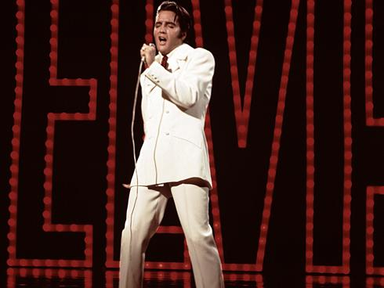
American Music

Slide 9
Pakistan Culture
How would you describe the Pakistan culture?
Popular movies?
Books?
Types of music?
Who are the celebrities?

Slide 10
Homework
Choose one of the following options:
Write a paragraph and draw pictures of the music, books, art, etc. that make up your culture.
Write a paragraph about what culture means to you. How does culture define you? Your country? The world?

