Slide 1
Vanderbilt-Pakistan Connection
October 2013

Slide 2
Share your homework!
If you are comfortable with it,
please perform your dance/
song you’ve created!

Slide 3
Check out the cool things
humans have done
with buildings
and architecture!
>>>>>>>

Slide 4
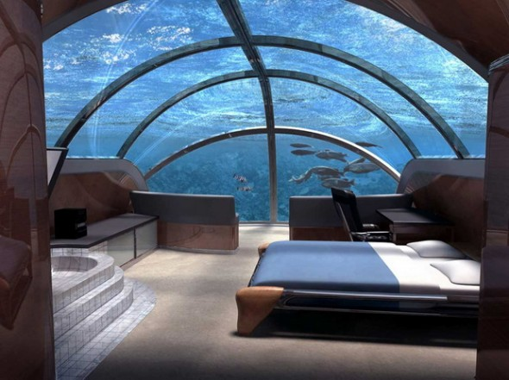
Hotel room underwater!
Would you sleep here?

Slide 5
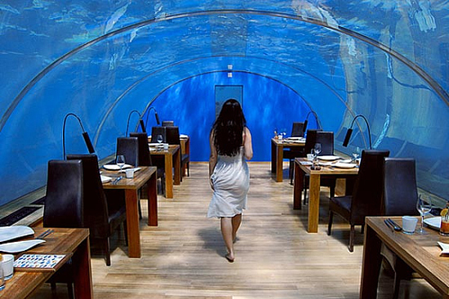
Underwater Hotel: Fiji

Slide 6
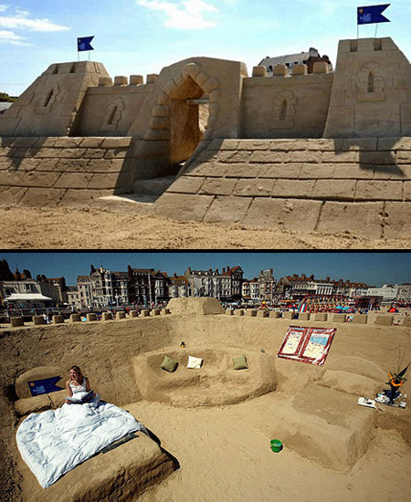
Sand
Castle
Hotel:
United
Kingdom

Slide 7
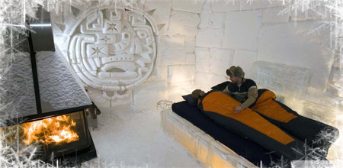
Ice Hotel: Canada

Slide 8
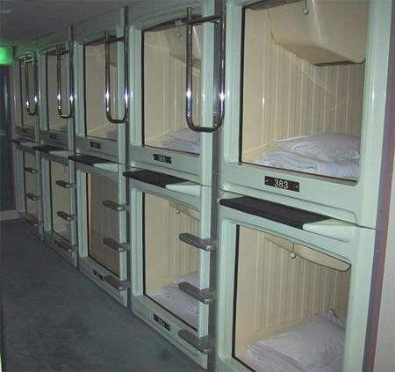
Small
Space
Hotel:
Japan

Slide 9
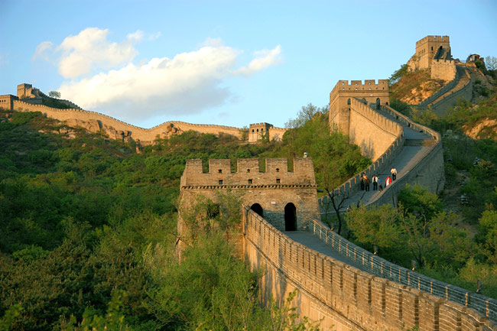
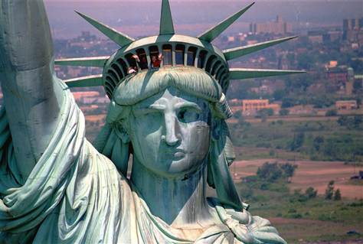
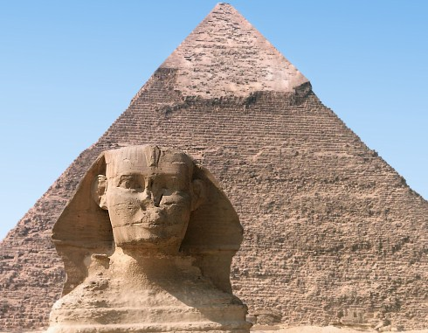
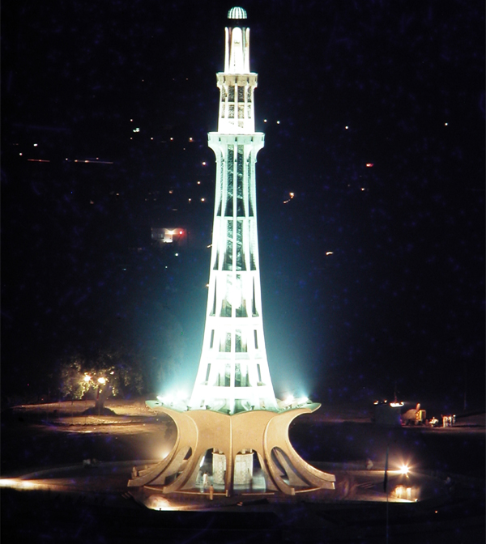

Slide 10
Which buildings/monuments
do you think will last the
longest in human history?

Slide 11

How will you
MAKE YOUR
MARK?
If you had to build one building to leave on this Earth in your memory, what would it look like? Would it be a statue of yourself? Would it look like something else? Draw a picture!

