Slide 1
Vanderbilt-Pakistan Connection
February 2013
Notes:
Here is where you will introduce yourself to your students. Talk about your major, your interests, etc etc.

Slide 2
Fog by Carl Sandburg
The fog comes
on little cat feet.
It sits looking
over harbor and city
on silent haunches
and then moves on.
Notes:
Initial vocab questions? Perish = die

Slide 3
Questions
What does the author compare fog to? Why do you think he chose this animal?
Haunches = butt and thigh
What is the mood of this poem?
Personification:
Why did the author describe the fog as a living thing?
The fog comes
on little cat feet.
It sits looking
over harbor and city
on silent haunches
and then moves on.
Notes:
Describing the fog as a cat makes it seem more mysterious and cunning, because cats are mysterious and cunning. They can move in and out of a room silently.

Slide 4
What animal would you use to describe a thunderstorm? What animal would you use to describe a sunny day?

Slide 5
Phenomenal Woman by Maya Angelou
Pretty women wonder where my secret lies.
I’m not cute or build to suit a fashion model’s size
But when I start to tell them,
They think I’m telling lies.
I say, It’s in the reach of my arms
The span of my hips,
The stride of my step,
The curl of my lips.
I’m a woman
Phenomenally
Phenomenal woman, That’s me.
Notes:
Ask the class if they understand all of the poem’s vocab and meaning. Barren = lifeless and unproductive

Slide 6
Questions
What is the author’s tone?
Phenomenal = extraordinary, uncommon
How does the author define being a “phenomenal” woman?
How can this poem relate to men? Do men also have pressure to look a certain way?
Pretty women wonder where my secret lies.
I’m not cute or build to suit a fashion model’s size
But when I start to tell them,
They think I’m telling lies.
I say, It’s in the reach of my arms
The span of my hips,
The stride of my step,
The curl of my lips.
I’m a woman
Phenomenally
Phenomenal woman, That’s me.
Notes:
If they don’t know what “tone” is, tell them it is the author’s emotion when they are speaking.

Slide 7
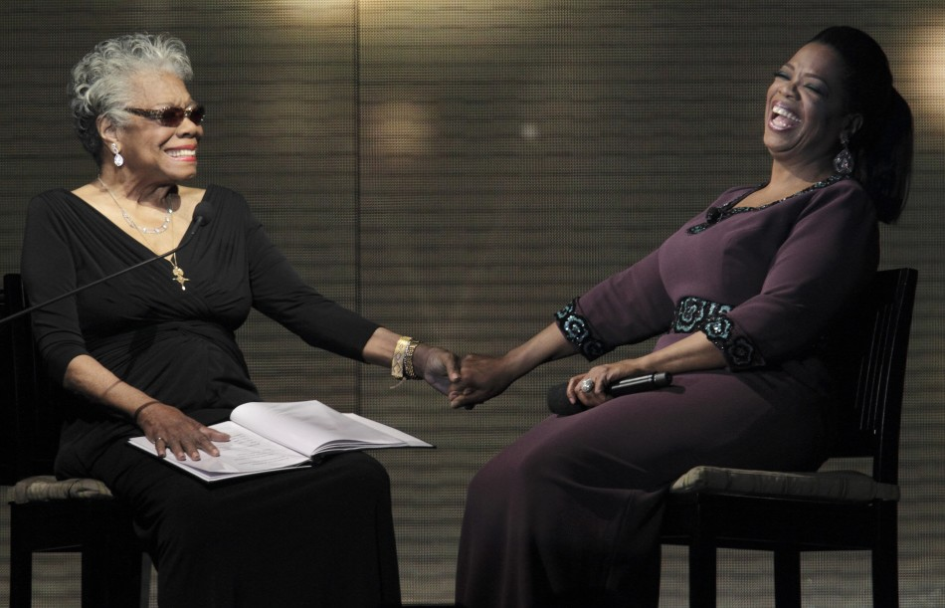
Maya Angelou (left) with famous
talk show host Oprah Winfrey (right)

Slide 8
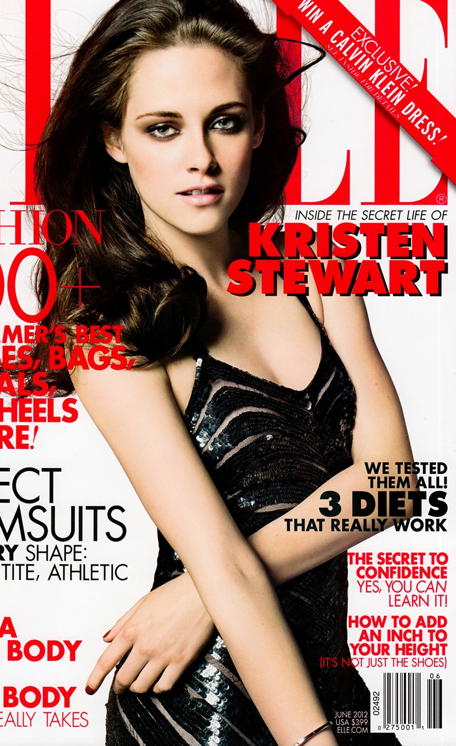
Magazine covers in the US and Pakistan
Notes:
Just describe that these are examples of magazine covers in the US and Pakistan.

Slide 9
What is the difference between Maya Angelou’s view of “phenomenal” and the media’s view of “phenomenal?”
Why do you think they are different?

Slide 10
Homework
Find magazine articles of men or women and write a paragraph about the similarities and differences between your country’s average man/woman and what is seen on the magazine.

